Slide 1
IB English Language and Literature
6 ELL SL 4
2019 - 2020
Shape of the Week (1):
Lesson 1: Prelim Prep – Commentary Writing
Lesson 2: Prelim Prep – Commentary Writing

Slide 2


SCHOOL ASSESSMENT TERM 3
☑ PRELIMS!!!

Slide 3
General Outline Term 3
WEEK 1 Paper 2 Prelim Prep
WEEK 2 Paper 1 Prelim Prep
WEEK 3 Prelims
WEEK 4 Prelims
WEEK 5 WT finalisation
WEEK 6 Chronicle
WEEK 7 Chronicle
WEEK 8 Chronicle
WEEK 9 Chronicle

Slide 4



We are still a digital classroom!

Slide 5

Homework
Fill out Firefly Handout Comparison Table for Orwell.

Slide 6
Part One:
The three learning outcomes for this section of the course:
Analyse how audience and purpose affect the structure and content of texts.
Analyse the impact of language changes.
Demonstrate an awareness of how language and meaning are shaped by culture and context

Slide 7
teachers should aim to illustrate... the meaning of texts is rarely fixed but is instead shifting and fluid, constantly affected by the impact of language change and the specific cultural contexts in which texts are produced and received.
Encourage students to develop an awareness of the fact..choices are made and that they have consequences and an impact in the social world—texts and their meaning, then, need to be understood as problematic rather than “natural”.

Slide 8
Look at these areas for study:
Language and power
Language and gender •
Language in translation •
Language history and evolution
Language and social relations
SEE P. 14 OF WRITTEN TASKS MISOGYNY AND RAP
Assessment focus for Part One
Paper 1 (practice)
Further oral (potentially summative) Written task 1 (potentially summative) (HL: Written task 2—potentially summative)

Slide 9
Part 2 Learning Outcomes
Examine different forms of communication within the media.
Show an awareness of the potential for educational, political or ideological influence of the media.
Show the way mass media use language and image to inform, persuade or entertain

Slide 10
  Develop skills of close analysis and analytical connection
• Recognize importance of contexts of writing/receiving
• Encourage appreciation of formal, stylistic and aesthetic qualities of texts
• Develop understanding of the impact of language, culture and context on the construction of meaning
• Encourage critical appreciation of interactions between text, audience and purpose
• Develop students’ oral/written powers of expression
• Study texts from different periods, styles and genres
Encourage appreciation of perspectives from other cultures

Slide 11
Language and political campaign
• Media and violence
• Media and Stereotypes/Gender)
• Media and Language and the state
Text Types: SEE P.18- OF WRITTEN TASKS
• Presentation (and oral presentation skills) Essay—analytical and persuasive (HL:comparative essay)
• Novel, Drama (film text)
• News report, Blog • Editorial
• Memoir • Opinion column • Instructions

Slide 12
Paper One SL:25%
At SL the students will be given a choice of two separate, previously unseen texts, together with guiding questions, and will be asked to offer an analysis of one of the two texts. The texts will be non-literary and may include:
• a complete piece of writing
a complete piece of writing with visual content
an extract from a longer piece of writing, or an extract from a complete piece of writing with visual content

Slide 13

Paper 1: 25%
Paper 1: Two unseen non-literary texts (what you study in Language Parts 1 and 2).
You choose ONE text and write an analysis (commentary) discussing context, audience purpose, format/ structure and linguistic devices/ language features. You have TWO guiding questions to direct your response.
25%, 20 marks, 1 hour 30 min

Slide 14
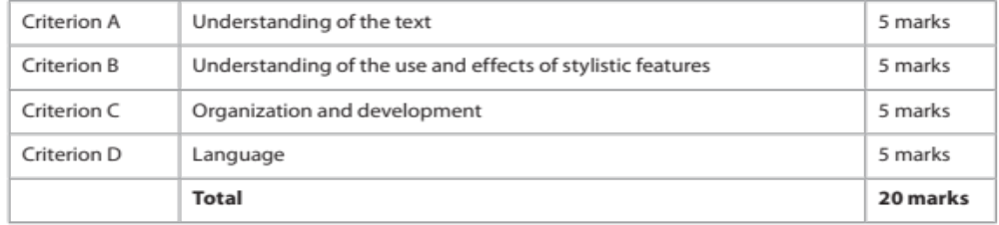
What you might see on Paper 1:
Two different non- literary texts to be read, for instance:
  advertisement
  opinion column
  extract from an essay
  electronic text (such as social networking sites, blogs)
  brochure (such as a public information leaflet)
  extract from a memoir, diary or other autobiographical text.
Two guiding questions at the end of each – choose ONE to analyse as written commentary in about 70 minutes.

Slide 15
Don’t forget the course guide/ syllabus!
You are expected to do certain things and demonstrate certain abilities.

Slide 16
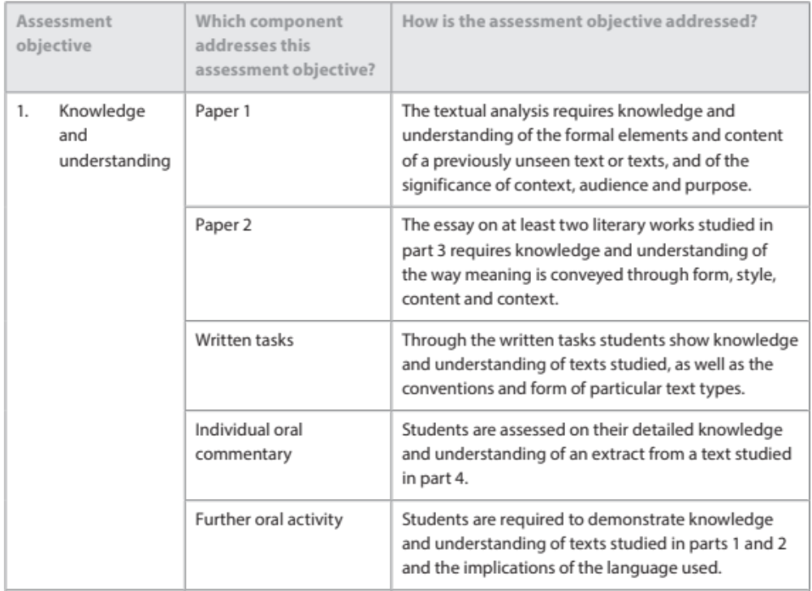

Slide 17
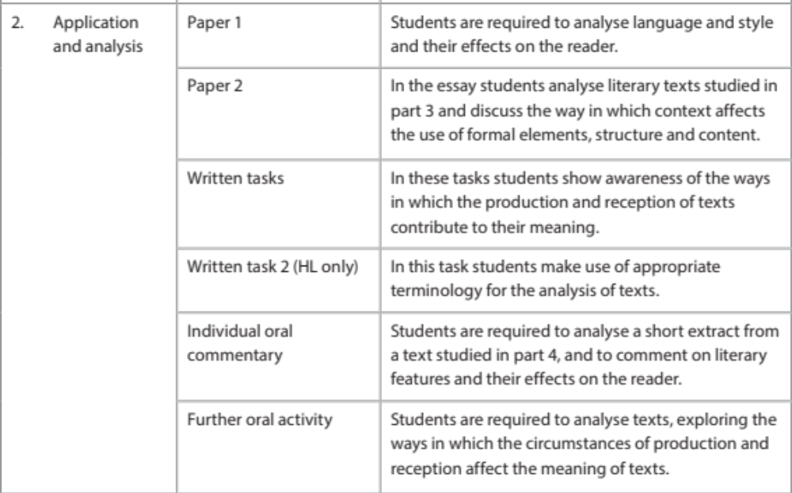

Slide 18
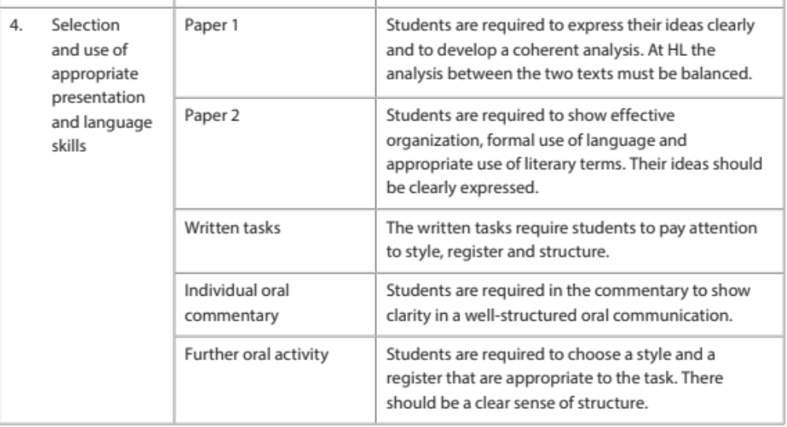

Slide 19
Go to Firefly
Open Paper 1 Template

Slide 20

Why do cats make better pets than dogs?
Make a spider diagram and then an alpha-numerical outline.
Create an introduction for this explanatory/ discursive essay!
You must have:
a Restate Question sentence
an Essay Map sentence

Slide 21
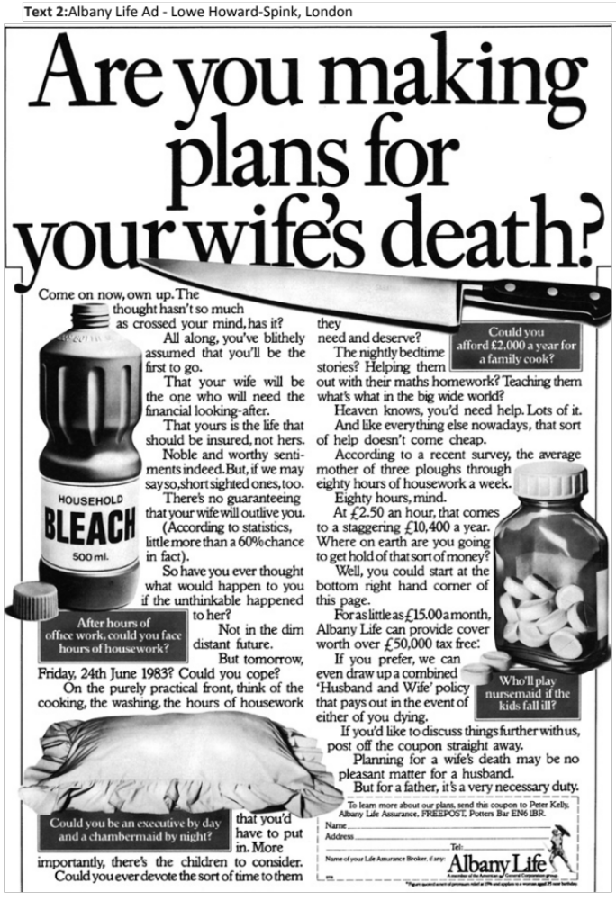
Use Handout 1 to analyse this Paper 1 text for The Big Five.

Slide 22
Model Intro
Lead-in
This British magazine advertisement for Albany Life insurance, created by Lowe Howard-Spink around the early 1980s uses a contrast between form and content to playfully approach a serious topic, producing a humourous yet memorable effect on the reader.
Thesis Statement
Targeting middle-aged and older married men, it aims to convince husbands to purchase life insurance for their wives. The ad’s theme of looking to the future and the event of unhappy possibilities is juxtaposed with its novel method of engaging responders with a light-hearted tone, rather than frightening them with dark predictions.
Essay Map
The mechanism of persuasion lies in the form and structure of the text, as well as the diction to maintain an authoritative, yet lively voice appropriate yet unconventional for content and context.

Slide 23

The Big 5 – Revision
There are several questions that you can ask of any text. Here are five major questions that apply to almost all types of texts:
Audience / purpose - Whom does the text target? What does the author wish to achieve through the text?
Content / theme - What is literally ‘happening’ in the text? What is it about? What are the main ideas of the text?
Tone / mood - How does the text make you and/or the target audience feel? Describe the atmosphere of the text.
Stylistic devices - How does the author use language to convey a sentiment or message? What kinds of linguistic tools does he/she employ?
Structure - How is the text organized, literally (i.e. layout/formatting)? What kinds of structural elements of a particular text type do you see?

Slide 24
Body paragraphs
Audience and Purpose Paragraph (PEEL)
Content and Theme Paragraph (PEEL)
Tone and Mood Paragraph (PEEL)
Technique Paragraphs (PETEL)
Follow the simple P.E.T.E.L. structure
P: State your topic sentence (what your paragraph will be about – a Point which supports Thesis Statement)
E: Refer to specific Example in the text
T: Identify a Technique used in the Example to create meaning about the Point. (Device or Structure)
E: Explain how this example supports the key concept you are discussing and
L: Link its effectiveness for the overall text.
(Use your Close Reading Template [Handout 4] to help guide you on what details to include)

Slide 25


Communication – Response Model
Language used
to create
meaning
Medium (text type)
Genre
Social Purpose
Theme
Ideas and values promoted
Style
Structure
Communication Process
Composer or producer of the text.
Context 1 - the immediate social, cultural and historical circumstances of the composition.
Responder or interpreter of text.
Context 2: the immediate social, cultural and historical circumstance of reception.
Meanings

Slide 26
PETEL Paragraphs
Now all of you may add more than one technique per PETEL paragraph!
Point – statement about communicating idea to responders.
Examples – of a particular technique the composer has used to communicate that idea. Techniques – discussion of the way in which the technique effectively communicates this. These should be addressed together, maybe in the same sentence.
Explanation – of the effect of technique on the responders.
Link – connects this point to the thesis statement overall.

Slide 27
Go to Firefly
Open Past Paper 2013

Slide 28
Model Intro
Lead-in
Thesis Statement
Essay Map

Slide 29
Homework
Fill out Firefly Handout Comparison Table for Orwell.

